Slide 1
Programming 4
10.1 Inheritance Approach and Avoid
Semester 2, 2019

Slide 2
Inheritance in OO - review
A group of classes are related in that they have a common core of shared functionality and/or data
Child classes extend parent (base classes) by descent
Child classes contain all public or protected data and methods of their ancestors
Inheritance promotes code reuse and reduces code duplication.
Child classes contain additional data, additional functionality or polymorphic implementations
The parent-child relationship must be an “is-a” relationship, not a “has-a” relationship

Slide 3
Inheritance in OO - review
Inheritance for extension
Base Class: Common Core
Child Class: + Specialised

Slide 4
Inheritance in OO - review
Inheritance for polymorphism
Base Class – Common Core
Including ImportantJob()
Child Class1
Implements ImportantJob() with algorithm 1
Child Class2
Implements ImportantJob() with algorithm 2

Slide 5
Dangers of inheritance
Cumbersome hierarchies – confusing to use
Single hierarchical structure not a good match for information architecture.
Hidden functionality in ancestors

Slide 6
Don’t use inheritance
...when it isn’t a true “is-a” relationship

Slide 7
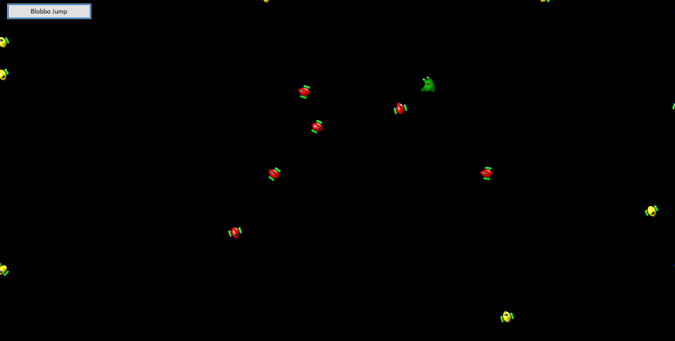
Practical
Approach-avoid

Slide 8
Practical
Use Inheritance InheritanceApproachAvoid Skeleton
Carefully study the existing classes, SimpleSprite, SpriteList and Form1. Read the comments in Form1.h
Add two new classes Approacher and Avoider, both descended from SimpleSprite, so that your
application runs as in the demo
Before creating your new child classes, decide:
What data members and methods do they inherit from their parent?
What additional data members (if any) do they each need?
What additional methods (if any) do they each need?
What inherited methods (if any) do they each need to override?
If you are going to add methods or override inherited methods, what is the logic for each one?

